Slide 1
Radiation Units
Charles Whitmer
2020.09.01

Slide 2
Four Different Types of Units
Activity
Dose-in-air
Absorbed Energy
Dose Equivalent

Slide 3
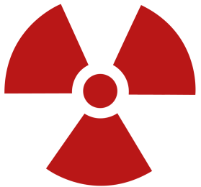
Activity
A measure of decays per second
Original unit: 1 Curie (Ci) = Number of decays from 1 gram of ²²⁶Ra in 1 second. This is 3.7x10¹⁰/sec.
New SI unit: 1 Becquerel (Bq) = 1 decay per second
Curies are still used as a measure of an amount of a material. A typical smoke detector contains 0.9 μCi of ²⁴¹Am.

Slide 4
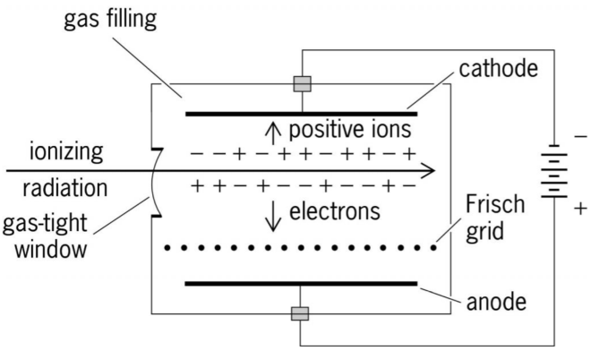
Dose in Air (Exposure)
This is a measure of how much ionization takes place in a volume of air.
1 Roentgen (R) = 2.58x10⁻⁴ C/kg
This is well suited to the easiest sort of radiation detector: the ionization chamber
An ionization chamber uses relatively low voltage.
Measures the current resulting from ionization.

Slide 5
Absorbed Energy
This is a measure of how much energy is deposited in a material or tissue. (Now called Kerma)
Old unit: 1 rad = 100 erg/g
New unit: 1 Gray = 1 Joule/kg = 100 rad
If you understand the physics, this is the easiest to calculate. So many interactions per meter, so much energy lost.
Unfortunately, this does not tell us the effect on tissue. Exactly how fast you lose the energy is important.

Slide 6
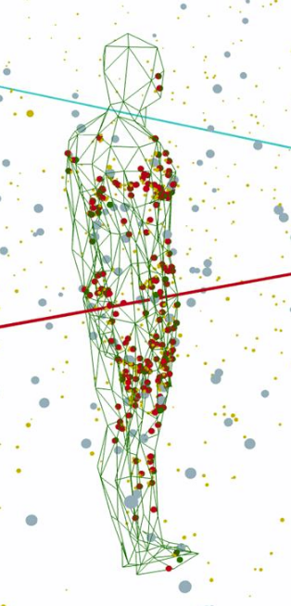
Dose Equivalent
Dose equivalent estimates the effect on the human body.
The measure begins with rad or Gray, the energy deposited, but adjusts it with a Q factor for the type of radiation.
Gamma and beta radiation have Q=1
Neutrons have Q=10
Alphas have Q=20
Older unit: rem (rad equivalent man) = Q x rads
New unit: Sievert (Sv) = Q x Grays
1 Sv = 100 rem

Slide 7
How dangerous is a Sievert?
A dose of 1 Sv is dangerous. It means about an 8% chance of developing cancer. If it is received all at once it will cause radiation sickness, but not immediate death. An acute dose (i.e. over a short period of time) of 5 Sv is deadly.
So we want to stay far away from that. A typical person will get about 2 or 3 mSv per year from background radiation. A radiation worker is allowed less than 50 mSv per year (above the usual background).
If we use a Geiger counter to measure the background at school, it typically reads 0.1 μSv/hr.

Slide 8
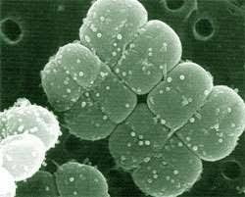
Is There any Safe Level of Radiation?
Government limits make the assumption that all radiation doses are additive, meaning that there is no safe level.
Some experiments tell a slightly different story. All living cells have “machinery” to repair damage to DNA, and cells can keep up with low rates of damage.
Trivia: An organism called D. radiodurans can absorb an astounding amount of radiation (5000 Grays!) with little effect.
Denver, CO, for example has a much higher background rate of radiation than other cities, due to its altitude. (An extra 1 to 2 mSv/year) But cancer rates in Denver do not stand out over other areas.

Slide 9
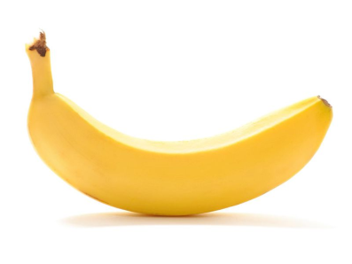
Other Units
When doing neutron physics we talk about the neutron flux, measured in neutrons/cm²/sec. This is something that we can model in software, and there are conversion factors to convert neutron flux to Sv/hr.
The Banana! (Or BED) A banana contains about 0.5 g of potassium, of which 0.012% is ⁴⁰K. This leads to about 15 Bq of activity, and an ingested banana can give a dose of about 0.1 μSv.

